Slide 1
Automated Patient History Summarization
AI Clinical Intelligence
Notes:
Today I will demonstrate a new AI-powered capability focused on one of the most common challenges faced by radiologists and clinicians: quickly understanding a patient's clinical history across multiple prior reports.
Our goal is not to replace clinical judgment.
Our goal is to provide immediate clinical context, reduce review time, and improve reporting efficiency.

Slide 2
The Clinical Challenge
Too Much Information, Too Little Time
Clinicians often review:
Multiple prior imaging reports
Historical findings
Follow-up recommendations
Reports from different modalities
Years of accumulated patient history
Challenges
Time-consuming review process
Important findings may be overlooked
Inconsistent understanding between readers
Increased reporting workload
Notes:
in many cases a reading phys must review several years of historical reports before finalizing a report.
The information exists, but extracting the clinically relevant story requires significant effort.
This creates inefficiency and increases cognitive load.

Slide 3
Vision
From Historical Reports to Clinical Intelligence
Traditional Workflow
Search → Open Reports → Read Reports → Build Mental Summary
AI-Assisted Workflow
Open Exam → Review AI Summary → Validate Findings → Report
Outcome
Faster review
Better clinical context
Improved consistency
Enhanced productivity
Notes:
The objective is simple.
Transform fragmented historical information into an immediately understandable clinical summary.
Instead of reading ten reports, the radiologist starts with a concise patient narrative.

Slide 4
Solution Overview
AI Patient History Summary
The solution automatically generates:
Patient Summary
Significant findings
Disease progression
Prior interventions
Follow-up recommendations
Historical trends
Generated from
Previous reports
Historical exams
Longitudinal patient history
Notes:
The solution continuously builds a consolidated patient history summary using existing reports already available in the system.
The result is a single source of clinical context.

Slide 5
Standards-Based Clinical Intelligence
Built on Healthcare Interoperability Standards
Summary Structure Guided By
USCDI v4 (United States Core Data for Interoperability) Provides standardized clinical data elements including: Problems & Conditions Procedures Medications Allergies Clinical Notes Diagnostic Reports | C-CDA (Consolidated Clinical Document Architecture) Provides industry-standard clinical document structure for: Patient History Encounter Information Findings Recommendations
Why We Use These Standards ✅ Clinically meaningful organization of information ✅ Consistent summary structure across customers ✅ Future interoperability readiness | ✅ Reduced customization effort ✅ Alignment with healthcare industry best practices
Notes:
One important design decision was not allowing the AI to freely invent its own summary structure.
Instead, we use established healthcare interoperability standards as the framework for organizing information.
USCDI v4 defines the key clinical data elements that are important for patient care and interoperability.
C-CDA provides a proven structure for organizing longitudinal clinical information.
By using these standards as guidelines, the generated summaries become more consistent, clinically meaningful, and future-proof.
This approach also supports our strategy of having a single mission that can work across all customers and exam types without requiring customer-specific customization.

Slide 6
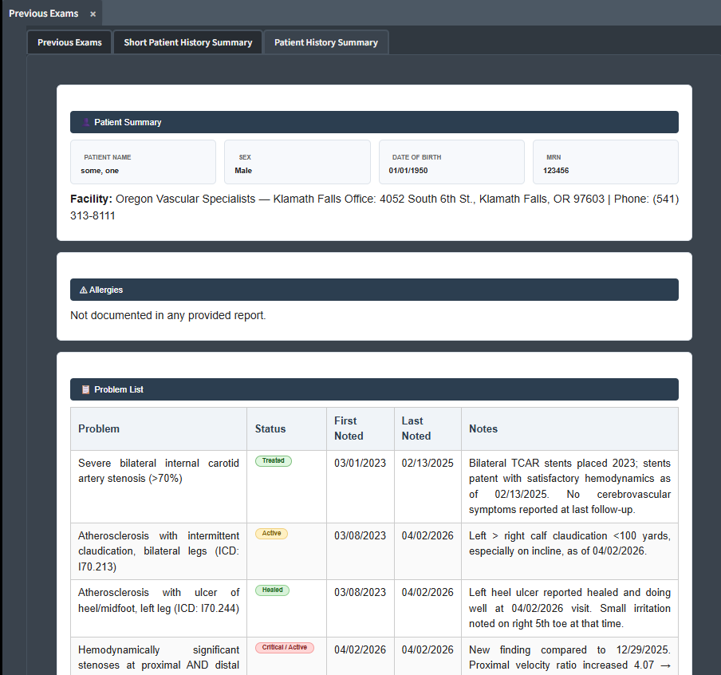
User Experience Demo
Summary Available Inside Existing Workflow
Key Characteristics
No workflow disruption
Embedded in reporting experience
One-click access
Clinically focused presentation
Notes:
The solution is integrated directly into the existing workflow so clinicians gain value without learning a new system.

Slide 7
AI Processing Strategy
Optimized for Performance and User Experience
Prefetch Generation
Triggered when an order is received
Final Summary Refresh
Triggered when report is verified by a physician
Why?
Ensures summaries are already available when clinicians need them.
Avoids waiting several seconds for on-demand AI generation.
Notes:
One important design decision was avoiding real-time generation whenever possible.
We use a prefetch strategy when orders are received and refresh summaries when reports are finalized.
This ensures the summary is ready before the user requests it.

Slide 8
Finding the Best AI Model
Finding the Best AI Model
We evaluated multiple Matcha AI models based on:
Clinical quality
Response time
Token consumption
Scalability
Cost efficiency
Key Findings
Some models generated higher quality summaries.
Some models provided faster responses.
Some models had limitations on the number of reports that could be processed efficiently.
Notes:
A significant portion of the effort focused on model evaluation.
Different models perform differently depending on report volume, complexity, and response requirements.
We tested multiple options to find the best balance between quality, speed, and operational cost.

Slide 9
Cost Optimization Strategy
Intelligent Token Management
Caching Mechanism
Benefits:
Reduces repeated AI requests
Minimizes token consumption
Improves response speed
Reduces operating cost
Result
More scalable deployment across large customer environments.
Notes:
AI cost management is an important consideration.
To reduce unnecessary token usage, we implemented caching so previously generated summaries can be reused when appropriate.
This improves performance while lowering operational costs.

Slide 10
AI Platform Flexibility
Current Solution
Matcha AI Models
Other Options
Internally Hosted Open Source Models
Examples explored:
Ollama-based deployments
Llama 70B models
Medical-focused open-source models
Why?
Cost optimization
Data sovereignty
Scalability
Vendor flexibility
Notes:
While Matcha AI is our primary platform today, we evaluated alternative deployment strategies.
We explored internally hosted open-source models as a contingency option should cost, volume, or deployment requirements evolve.
This gives us flexibility and protects future investment.

Slide 11
Product Strategy
One Mission for All Customers
Design Principle
Single summarization mission
Supports
All exam types
All specialties
All customer environments
Benefits
Simpler deployment
Easier maintenance
Reduced customization effort
Faster upgrades
Notes:
A deliberate design decision was to avoid customer-specific missions.
Instead, we are targeting a single mission capable of supporting all exam types and customer environments.
This dramatically simplifies implementation and long-term support.

Slide 12
Compatibility & Rollout Strategy
Designed for Existing Customers
Supported Versions
Current Customers
Version 5.21
Future Deployments
Version 5.22
Benefits
Faster customer feedback
Larger pilot audience
Reduced upgrade barriers
Notes:
We are intentionally designing the solution to work with our current customer base.
Supporting version 5.21 allows us to collect real-world feedback earlier rather than waiting for future releases.

Slide 13
Closing
From Historical Reports to Actionable Clinical Intelligence
Better Context
Smarter Reporting
AI-Powered Clinical Workflows
Notes:
The value extends beyond clinical productivity.
This initiative demonstrates a practical and scalable use of AI that benefits customers while strengthening our product strategy.

Slide 14
The Future of Patient Care
Notes:
In conclusion, Matcha AI represents a significant step forward in patient care. By automating summarization, we empower clinicians to work more efficiently and effectively. Thank you. I'm now happy to answer any questions.

